Slide 1
Initial Assessment in Counseling
PSY 504: Psychological Measurement

Slide 2
Initial Intake Interview
Expectations that clients build during the initial sessions have a significant influence on outcome
Quality of therapeutic relationship during early sessions, rather than later sessions, significantly predicts long-term positive results
Client problems are rarely related to one factor, are usually multidimensional, and typically occur in a social context
Important to balance gathering information and building a therapeutic relationship

Slide 3
Information Gathered in the Initial Interview
Demographic information
Background information
  This process is sometimes referred to a psychosocial interview (see Table 6.1)

Slide 4
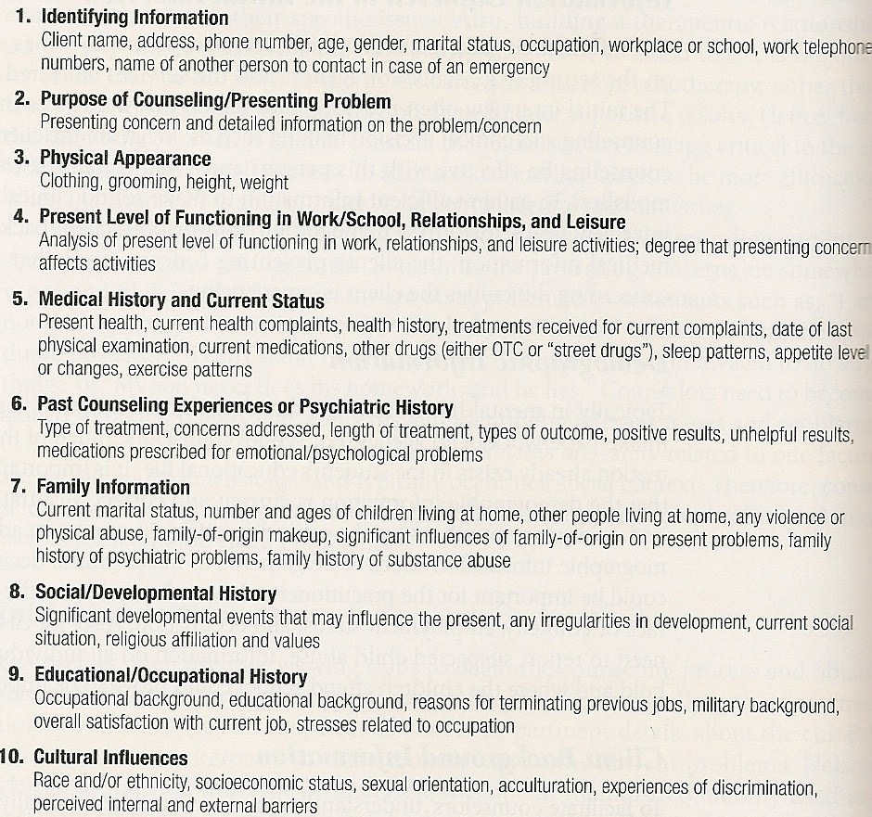
Information Gathered in the Initial Interview
Background
Information

Slide 5
Information Gathered in the Initial Interview
Presenting concerns (consider):
  When the problem started (including precipitating factors)
  Frequency (intensity and duration) of the problem
  Maintaining factors
  Past methods to deal with the problem (effective and noneffective)
  Relevant surrounding events and multiple perspectives
  Impact of problem on client’s daily functioning
  Asses the degree to which the client believes each problem is changeable and motivation to change (including hope)
    Also consider internal vs. external motivation to change

Slide 6
Defining the Client’s Problem
Important to eventually develop a solid case formulation that will be driving force of your treatment goals and interventions
  The case formulation is malleable over time as new information is learned
Underestimating the severity of the client’s problems is one of the major reasons counseling can result in a negative outcome
Often clients seek counseling for multiple issues rather than one specific problem

Slide 7
Assessing the Change Process
Prochaska’s Transtheoretical Model:
1. Precontemplation – client has no intention of changing behavior in the foreseeable future
2. Contemplation – client becomes aware that a problem exists and considers the problem; but no commitment to action
3. Preparation – client begins to make small changes in behavior, with the intention of taking action within the next month

Slide 8
Assessing the Change Process
Prochaska’s Transtheoretical Model:
4. Action – client overtly changes/modifies their behavior, experiences, or environment to address their problems
5 Maintenance – client works on preventing relapse and to consolidate the gains achieved in the action stage; this is a continuation of the changed behavior

Slide 9
Interviewing Skills and
Techniques
Clients who perceive their counselors as trustworthy, expert, and attractive have better outcomes in counseling than clients who do have these perceptions of their counselors
  *See Strong (1968; pp. 221-222)
        Expertness - Conducting yourself as confident in theory and practice (e.g., psychoeducation, case formulation, treatment goals, interventions) can enhance client perception of expertise
        Trustworthiness - Respecting client confidentiality and following policies and procedures naturally produces relational trust
        Attractiveness – likeability and compatibility that comes from how you conduct yourself during client interactions

Slide 10
Interviewing Skills and
Techniques
Open-ended questions are less likely to lead or influence the client and require a more elaborate answer than closed-ended questions
Basic counseling skills: paraphrasing, clarifying, reflecting, restatement, interpreting, summarizing
Self-awareness of verbal and nonverbal communication
Almost all interviews are semi-structured
  Combination of structured and unstructured; certain questions are always asked, but there is room for exploration and additional questions

Slide 11
Interviewing Children
Establish rapport and familiarity
Gear vocabulary to child’s educational level; reduce complexity of questions
Ask questions in a warm professional manner
Explain why asking questions
Define limits of confidentiality
Use variety of question types; avoid abstraction
Use physical props, games, toys
Observe behavior during interview
If disruptive play, do not immediately stop behavior

Slide 12
Assessment of Depression
Know the symptoms – cognitive, emotional, behavioral (and physiological)
Assess severity and type of depression
Formal instruments
  Beck Depression Inventory-II (BDI-II)
  Children’s Depression Inventory-2 (CDI-2)
  Hamilton Depression Inventory (HAM-D)

Slide 13
Assessment of Suicide Potential
Suicide is the 10th leading cause of death in the U.S. (NIMH, 2016)
  2nd leading cause of death for 10-14, 15-24, 25-34
  *More than twice as many suicides in the US than homicides
Men are more likely to commit suicide, but women are more likely to attempt suicide
  Men aged 65 and older have the highest rate
American Indian/Alaska Natives have the highest suicide rate
  Next is White/Non-Hispanic

Slide 14
Assessment of Suicide Potential
Most common method used in suicide deaths in the US
  Total Suicides (2016): 44,965
    Firearm: 22,963
    Suffocation: 11,642
    Poisoning: 6,698
    Other: 3,662
Single, divorced, or widowed are at a greater risk
71% of counselors have worked with individuals who had attempted suicide
  28% of those practitioners had a client who had committed suicide

Slide 15
Assessment of Suicide Potential
Important factors to consider:
  Alcohol/drug use
  Hopelessness/helplessness
  Previous attempts
  Access to lethal means (and plan)
  Recent loss, divorce, or separation
  Personality factors
    Impulsivity, inability to express emotions, perfectionism and super responsibility, sensitivity, pessimism, and dependency
  Personality disorder
    Especially those with borderline or antisocial personality disorder

Slide 16
Assessment of Suicide Potential
Important factors to consider (cont.):
  History of psychiatric disorder
    e.g., About 10% of individuals with schizophrenia commit suicide, often in the first few years of the illness
    e.g., major depression and alcoholism account for 57-86% of all suicides
  Consider “protective” factors
    Being married or in a significant relationship
    Having children under the age of 18
    Having a “general purpose” for living and a support system
    Employment or involved in a structured program

Slide 17
Assessment of Suicide Potential
Stelmachers’ (1995) recommended areas of concentration for clinicians assessing the risk of suicide:
  Verbal communication
  Plan
  Method
  Preparation
  Stressors
  Mental State
  Hopelessness

Slide 18
Assessment of Suicide Potential
Formal Instruments
  Beck Scale for Suicide Ideation (BSS)
  Beck Hopelessness Scale (BHS)
  Suicide Probability Scale
  Suicidal Ideation Questionnaire
  Adult Suicidal Ideation Questionnaire

Slide 19
Assessment of Substance Abuse
In most mental health settings between 29% and 50% of the individuals seeking services will also have a substance use disorder
If the possibility of a substance problem is detected during the screening period then the following steps should be followed (Adesso et al., 2004):
  Screening
  Brief problem assessment
  Diagnosis
  Comprehensive pretreatment problem assessment
  Treatment-related factors
  Outcome assessment

Slide 20
Assessment of Substance Abuse
Explore possibility of substance use and abuse early in counseling (alcohol, over-the-counter, prescription, and street drugs)
Consult Physician’s Desk Reference to be knowledgeable about side effects
  *There are also great phone/tablet applications
Assess social and interpersonal aspects of substance abuse
Identify internal and external triggers that precede the use of the substance
Identify whether you can provide appropriate treatment or whether to refer the client elsewhere

Slide 21
Assessment of Substance Abuse
CAGE interviewing technique (Mayfield, McLeod, & Hall 1974)
    1. Have you ever felt you should Cut down on your drinking?
    2. Have people Annoyed you by criticizing your drinking?
    3. Have you ever felt bad or Guilty about drinking?
    4. Have you ever had a drink first thing in the morning to steady your nerves or get to rid of a hangover (Eye opener)?
“Acid test” – ask client to control or limit their drinking

Slide 22
Assessment of Substance Abuse
Formal instruments:
  Substance Abuse Subtle Screening Inventory (SASSI)
  Drug Abuse Screening Test (DAST)
  Michigan Alcohol Screening Test (MAST)

Slide 23
Common Masquerades
There are some medical conditions that can mimic psychological symptoms/disorders (*see handout*)
  Brain tumors
  Epilepsy
  Hypoglycemia
  Hypothyroidism
  Hyperthyroidism
  HIV/AIDS
  Mononucleosis
  Chronic fatigue syndrome
  Drug induced disorders

