Slide 1
Selection, Administration, Scoring, & Communicating Assessment Results
PSY 504: Psychological Measurement

Slide 2
Identification of Assessment Instruments or Strategies
Determine what information is needed
Analyze strategies for obtaining information
  Formal/informal techniques?
  Consider method most suitable to the client, if possible (e.g., paper-and-pencil self-report, behavioral checklist, computer assessment)
  Consider own professional limitations and the types of instruments that can be ethically administered and interpreted

Slide 3
Identification of Assessment Instruments or Strategies
Search Assessment Resources
  Mental Measurements Yearbook
  Educational Testing Service Test Link
  Test Critiques
  Tests: A Comprehensive Reference for Assessments in Psychology, Education, and Business
  Directory of Unpublished Experimental Mental Measures

Slide 4
Identification of Assessment Instruments or Strategies
Evaluating the Instrument
  Instrument purpose
  Instrument development
    There should be concern if detailed information about the development of an instrument is not provided
  Appropriate selection of norming group or criterion
    Norming group considerations: age, gender, ethnic makeup, socioeconomic representation, educational level, geographic location; size of the norming sample
    If criterion referenced then must evaluate the actual criterion

Slide 5
Identification of Assessment Instruments or Strategies
Evaluating the Instrument (cont.)
  Reliability
    Type of instrument affects how the reliability coefficients are evaluated
    Should also consider methods used for determining the coefficients
  Validity
    Examine the validation evidence for support to use an instrument in a specific manner or context
  Bias
    Evidence should be provided that the instrument was evaluated for possible bias

Slide 6
Identification of Assessment Instruments or Strategies
Evaluating the Instrument (cont.)
  Interpretation and scoring manuals
    Should consider how the information is going to be used in counseling and what would be the most effective way to share the information with the client
    Should also consider how the instrument is scored
  User Qualifications
    Level A, B, C (next slide)
  Practical Issues
    Cost
    Time

Slide 7
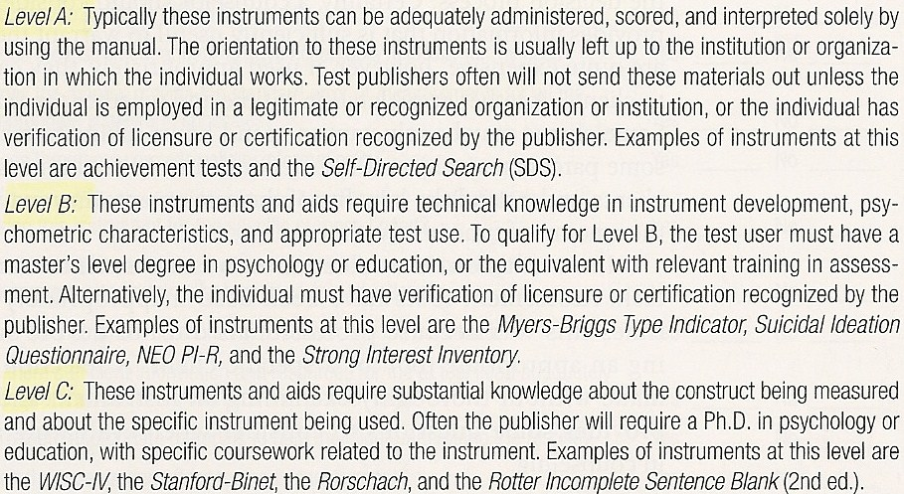
Identification of Assessment Instruments or Strategies
User Qualifications

Slide 8
Administering Assessment Instruments
Read administration materials before time of administration
Be aware of the precise instructions for administration: attend to time limits, methods for administering items and gathering responses, and be familiar with testing materials/equipment
Know the boundaries of what is acceptable (e.g., administration)
Use a checklist, if helpful

Slide 9
Scoring
By hand versus computer-scored
Before using a computer service, investigate integrity of scoring service and steps used to develop program
Issues with computer-generated interpretation
  Can result in poor training and/or assessment can be conducted without appropriate professional oversight
Some instruments require clinical judgment as part of the scoring process

Slide 10
Scoring
Performance & Authentic Assessment
  Typically goes beyond paper-and-pencil tests to assessment that more closely approximates the skill being measured
  Authentic assessments involve the performance of “real,” or authentic applications rather than proxies, or estimators, of actual learning
  Performance assessment typically includes performance on open-ended tasks, which are evaluated
  All authentic assessments are performance assessments, but the reverse is not always true
  In the text, performance assessment refers to both

Slide 11
Scoring
Scoring of Performance Assessment is enhanced if:
  Assessment has a specific focus
  Scoring plan is based on qualities that can be directly observed
  Scoring is designed to reflect the intended target
  The setting for the assessment is appropriate
  Observers use checklists or rating scales
  The scoring procedures have been field-tested before they are used

Slide 12
Communicating Results
Communicating results to clients is often one of the most important aspects of the assessment process
Communication of testing or assessment results should not be perceived as a discrete activity, but should be interwoven into the counseling
Research
  Surprisingly sparse research related to communication of results
  Some research found sharing personality assessment results can be therapeutic
  Tentative interpretations tend to be perceived as more helpful than absolute interpretations
  Clients prefer individual interpretation
    This may not always be an option due to cost

Slide 13
Communicating Results
Communicating Results to Clients:
  Know information in manual
  Prepare client to receive feedback – results tied to reason for assessment
  Use effective general counseling skills
  Develop multiple methods
  Minimize jargon and use visual aids when necessary
  When possible, use descriptive terms rather than numerical scores – provide a range of scores rather than just one score
  When available, explain results in terms of probabilities rather than certainties (avoids presenting assessment results as infallible)

Slide 14
Communicating Results
Communicating Results to Clients: (cont.)
  Tentative interpretations are perceived as more helpful than absolute interpretations
  Discuss results in context of other information
  Involve client in interpretation
  Use nontechnical terms in discussing limitations of results
  Encourage to ask questions, share reactions, provide feedback
  Summarize results

Slide 15
Communicating Results
Communicating Results to Parents:
  Should understand the testing used and the symptoms of the disorder
  Understand parents view if their child has been diagnosed with a disorder
  Results may need to be discussed more than once
  Be prepared to use a variety of techniques
  Help parents focus on the child’s abilities and not just the disabilities
  Focus on active, coping approach rather than a succumbing, victim framework
  Acknowledge parent’s emotions
  Monitor parent’s responses so the child does not internalize their negative reactions

Slide 16
Psychological Reports
Purpose is often to disseminate assessment information to other professionals
Counselors must evaluate quality of a report before implementing interventions based on its content
Expect a comprehensive overview of client and an interpretation of results in contextual manner
Should be carefully crafted with attention to detail
Be alert for typographical errors, use of vague jargon, and careless mistakes.

Slide 17
Psychological Reports
Common areas:
  Identifying Information
    Provides basic demographic information
      Name, date of examination, date of birth, chronological age, gender date of report, grade (if applicable), examiner’s name, tests administered
  Reason for Referral
    Includes: name and position of referral source, reason for referral, brief summary of the symptoms, behaviors, and circumstances that lead to the referral
    Should be a direct connection between reasons for referral and instruments/procedures utilized
  Background Information
    Includes: significant past events, educational history, current family dynamics, notable physical/mental health events, relevant past/current past employment, other assessments

Slide 18
Psychological Reports
Common areas: (cont.)
  Behavioral Observations
    Includes: physical appearance, comments/reactions to the process, responses to different assessment activities, unusual mannerisms or behaviors, variations in activities, changes in voice tone and facial expressions
  Assessment Results and Interpretations
    The longest section of the psychological report
    Includes: assessment findings, meaning of the results, clinical and diagnostic impressions
    Focus should be on interpreting rather than reporting findings
    Should include an exploration of the client’s strengths and limitations

Slide 19
Psychological Reports
Common areas: (cont.)
  Recommendations
    Future actions that will be beneficial to the client
    Should be sufficient detail so recommendations can be easily implemented
  Summary
    Succinct summarization of the entire report, with a focus on the results and interpretation
    Typically only 1-2 paragraphs
  Signature
    Name, degree, and professional title
    Sign name above typewritten name

