Slide 1
Validity &
Item Analysis
PSY 504: Psychological Measurement

Slide 2
Validity
Concerns what the instrument measures and how well it does that task
Not something an instrument has or does not have
  The instrument is not validated… it is the uses of the instrument that are validated
Informs counselor when it is appropriate to use the instrument and what can be inferred from the results
Reliability is a prerequisite for validity

Slide 3
Movement Away from Traditional Categories of Validity
Traditional types of validity
  Content-Related – the degree to which the evidence indicated that the items, questions, or tasks adequately represent the intended behavior domain
  Criterion-Related – the extent to which an instrument was systematically related to an outcome criterion (i.e., is it a good predictor?)
  Construct-Related – the extent to which the instrument may measure a theoretical or hypothetical construct or trait
  Face Validity – not really validity; refers to whether the test “looks valid” based on the content/questions

Slide 4
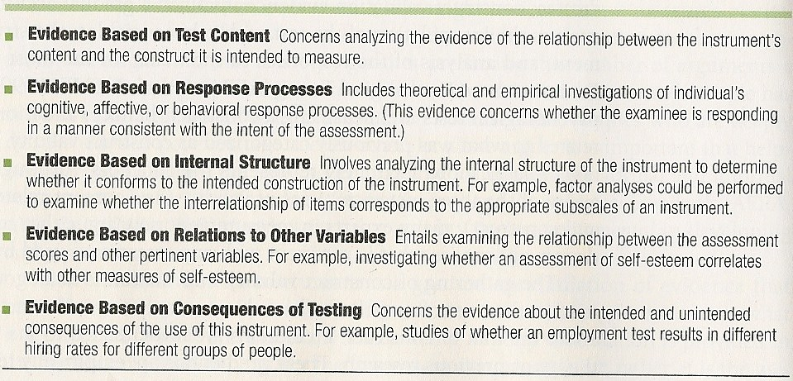
Validation Evidence
Related to what was previously categorized as construct validity with an emphasis on the techniques used in the scientific method
  The accumulation of evidence is evaluated to determine an instrument’s construct validity
  Validation is a shared responsibility among the developers of the instrument and the practitioner

Slide 5
Evidence Based on
Instrument (Test) Content
Related to the traditional term content validity
The degree to which the evidence indicates the items, questions, or tasks adequately represent the intended behavior domain (or construct)
Central focus is typically on how the instrument’s content was determined
Content-related validation evidence should not be confused with face validity

Slide 6
Evidence Based on the
Response Processes
Concerns whether individuals either perform or respond in a manner that corresponds to the construct being measured – information processing
Can examine the response processes used by different groups
Computer simulated performances to compare performance to the model-based answers produced by the computer

Slide 7
Evidence Based on Internal Structure
Examine whether the items in one subscale are related to other items on that subscale
  Done by examining the internal structure of the instrument
    Factor Analysis – statistical technique used to analyze the interrelationships of a set or sets of data
Can study the internal structure of an assessment with different groups (e.g., gender, race or ethnicity)

Slide 8
Evidence Based on Relations to Other Variables
Correlational method
  Convergent evidence/Discriminant evidence
Prediction or instrument-criterion relationship
  Concurrent and predictive validity
  Regression
  Decision Theory
Validity Generalization
(Evidence-Based on Consequences of testing)

Slide 9
Correlational Method
Correlational method – examines the relationship between an instrument and other pertinent variables or a criterion
  The performance on the instrument is correlated with the criterion information, which results in a validity coefficient
    Validity coefficients from different instruments can be compared
    Validity coefficients also allow for examining the amount of shared variance between the instrument and pertinent variables

Slide 10
Correlational Method
Can also compare an instrument with another instrument
  Convergent evidence – an instrument is related to other variables to which it should theoretically be positively related
  Discriminant evidence – an instrument is not correlated with variables from which it should differ

Slide 11
Prediction or Instrument-Criterion Relationship
Sometimes want an instrument that predicts future behavior (associated with the traditional criterion-related validity)
  Concurrent Validity – there is no time lag (relatively speaking) between when the instrument is given and when the criterion information is gathered
    Used for “immediate prediction”
  Predictive Validity – there is a time lag between when the instrument is administered and the time the criterion information is gathered

Slide 12
Prediction or Instrument-Criterion Relationship
Regression – often used to determine the usefulness of a variable, or a set of variables, in predicting another important or meaningful variable (closely related to correlation)
  Based on the premise that a straight line – a regression line – can describe the relationship between the instrument’s scores and the criterion
    The regression line, or line of best fit, allows for predicting performance on the criterion based on scores on the instrument
      Y’ is the predicted score; a is the y-intercept; b is the slope; X is the score on the instrument
Y' = a + bX

Slide 13
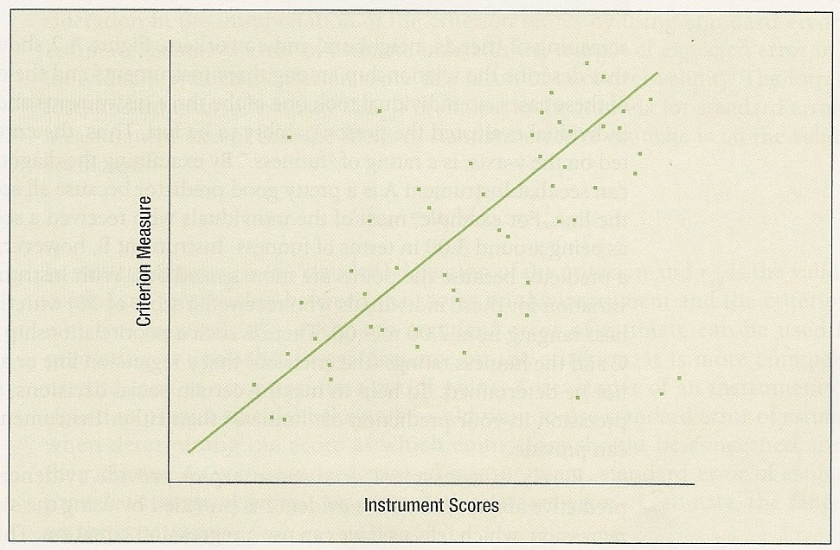
Prediction or Instrument-Criterion Relationship
Regression Line

Slide 14
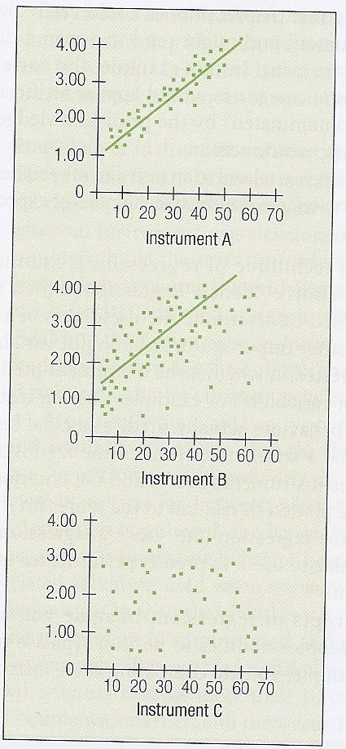
Prediction or Instrument-Criterion Relationship
Comparing three instruments with a regression line

Slide 15
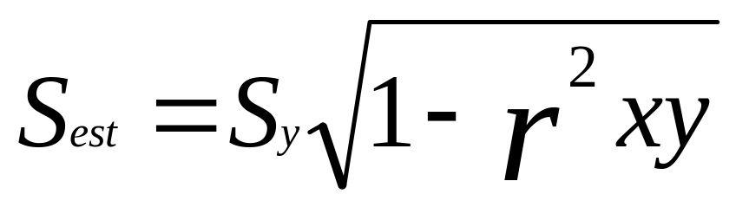
Prediction or Instrument-Criterion Relationship
Standard Error of Estimate – indicates the margin of expected error in an individual’s predicted criterion score as a result of imperfect validity
  Sy = standard deviation of the criterion
  rxy = validity coefficient (which is then squared)
  Typically used to look at error around a cutoff point

Slide 16
Prediction or Instrument-Criterion Relationship
Decision Theory – evaluates the accuracy of the decision making of an instrument based upon the relationship between the instrument and a criterion or predictor variable
  Often done through expectancy tables
  How often is the instrument is right (hit) and how often the instrument is wrong (miss)
    Helps in determining cutoff scores
    False Positives – instrument predicts the individuals have “it” (the criterion) when in fact they do not
    False Negatives – the instrument predicts the individuals do not have “it” when in fact they do

Slide 17
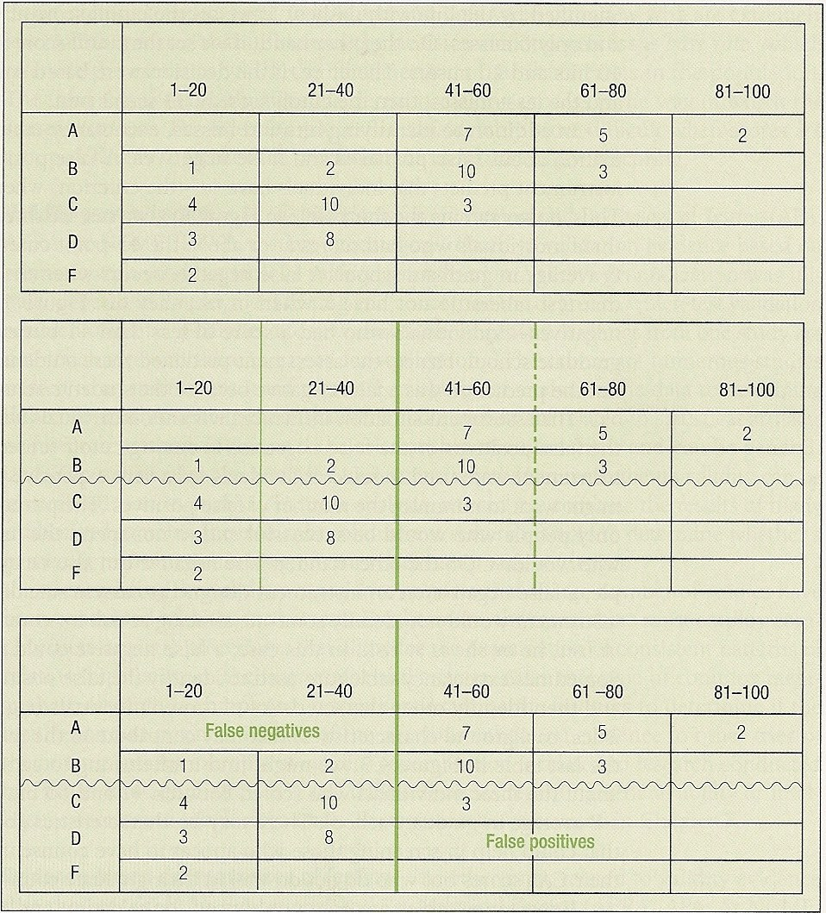
Prediction or Instrument-Criterion Relationship
Expectancy tables with false negatives and false positives
Misses
Hits
Hits
Misses
False -’s
False +’s

Slide 18
Validity Generalization
A method of combining validation studies to determine if the validity evidence can be generalized
  Must be a substantial number of studies
  Meta-analysis

Slide 19
Evidence-Based Consequences of Testing
Must consider consequences when using an instrument (e.g., racial/ethnic group differences)
  Group differences on tests used for employment selection
  Group differences in placement in special education
Consider social implications when examining the validation evidence
  Ethical responsibility to consider what is in the client’s best interest

Slide 20
Conclusion on Validation Evidence
Validity of an instrument is based on the gradual accumulation of evidence
Counselor must evaluate the information to determine if it appropriate for which client under what circumstance
Validation evidence should also be considered in informal assessments

Slide 21
Item Analysis
Item Analysis - focus is on examining and evaluating each item on an instrument
Item Difficulty – proportion of people getting an item correct (technically shows how easy the item is)
p = # who answered correctly
total number
Item Discrimination – provides an indication of the degree to which an item correctly differentiates among the examinees on the behavior domain of interest
  Examinees are divided into two groups based on high/low scores
    Then subtract the proportion in the lower group from the proportion in the upper group who got the item correct:
      d = upper % - lower % (for normal distribution: use upper 27% and lower 27%)
+1.00 = all upper group correct; none lower group correct
-1.00 = none upper group correct; all lower group correct

Slide 22
Item Response Theory
(Latent Trait Theory)
Item Response Theory – focus is on each item and on establishing items that measure the individual’s ability or level of a latent trait
Involves examining the item characteristic function (or item characteristic curve) and the calibration of each individual item – slanted “S curve” is often desired
Parameters:
    Difficulty – typically looking for a correct response of 0.50
    Slope – typically steeper slopes indicate the item is a good discriminator; flat slopes are not good discriminators
    Basal level – an estimate of the probability that a person at the low end of the trait or ability scale will answer correctly (“probability of guessing”)
Item response approach is not dependent on a norming group (SEM will differ across scores)

Slide 23
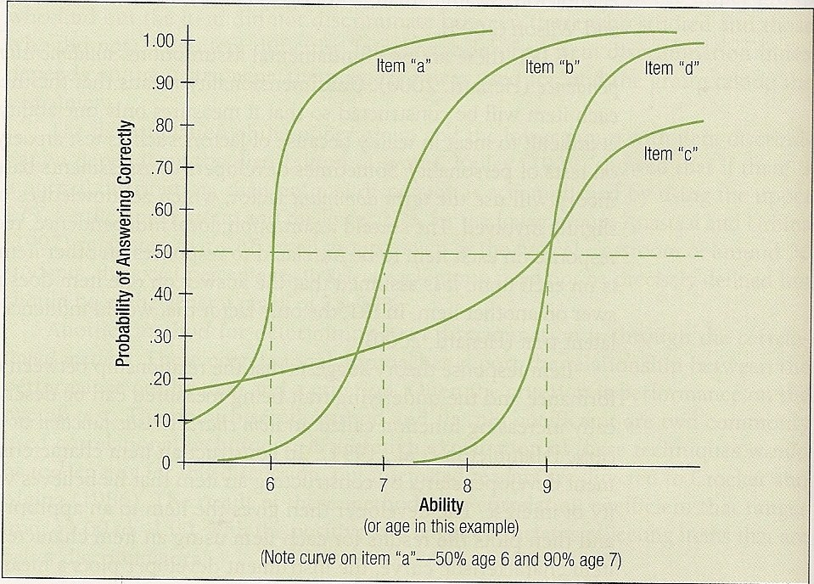
Item Response Theory
(Latent Trait Theory)
Item characteristic curves

Slide 24
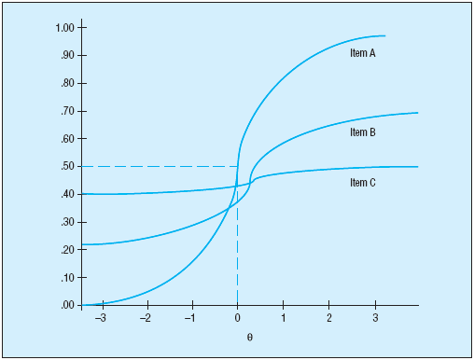
Item Response Theory
(Latent Trait Theory)

