Slide 1
Reliability
PSY 504: Psychological Measurement

Slide 2
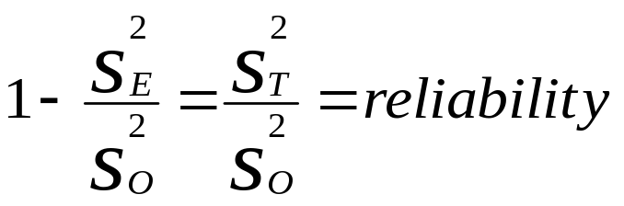
Classical Test Theory
Every observed score is a combination of true score (i.e., ability) plus error
Classical test theory suggests that every score has two hypothetical components: a true score and an error component
  Obs. = T + E
    Where Obs. is the observed score; T is the true score; E is the error
Use a reliability coefficient to give an estimate of how much of the variance is true variance and how much is error variance

Slide 3
Reliability
Reliability is:
  The consistency of measurements when the testing procedure is repeated on a population of individuals or groups
  An estimate of the proportion of total variance that is true variance and the proportion that is error variance
Systematic errors are constant errors that do not fluctuate
  Each test taker affected equally
Unsystematic errors are those errors that are not constant
  e.g., administration of the instrument
Reliability only measures unsystematic error (error variance is only unsystematic error)

Slide 4
Correlation
Correlation – a statistical technique that is often used in estimating reliability by providing an indication of consistency by examining the relationship between two scores
Correlation coefficient – a numerical indicator of the relationship between two sets of data

Slide 5
Correlation
Correlation coefficient ranges from –1.00 to +1.00
Closer to 1.00 or -1.00, the stronger the relationship between the variables
  No correlation = 0.0
  Perfect correlation = -1.00 OR +1.00
Positive correlation – variables are related in the same direction
  As one increases, the other increases; as one decreases, the other decreases
Negative correlation – variables are related in the opposite direction
  As one increases, the other decreases
CORRELATION DOES NOT PROVE CAUSATION!!!

Slide 6
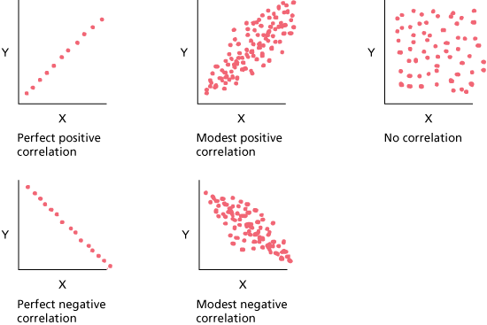
Correlation

Slide 7
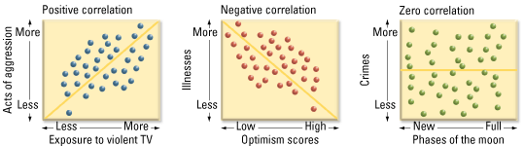
Correlation

Slide 8
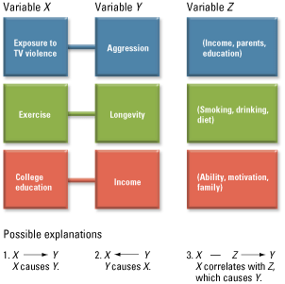
Correlation
Correlation does NOT prove causation

Slide 9
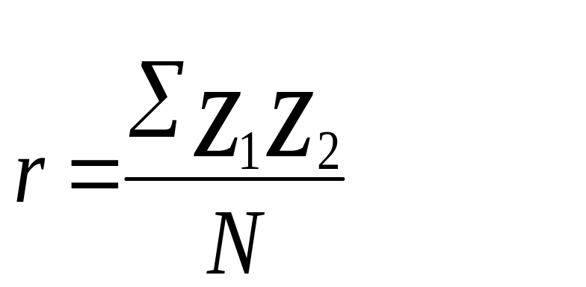
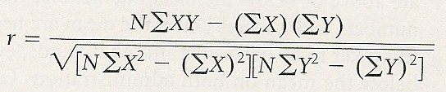
Correlation
Pearson-Product Moment Correlation
  Another way to calculate

Slide 10
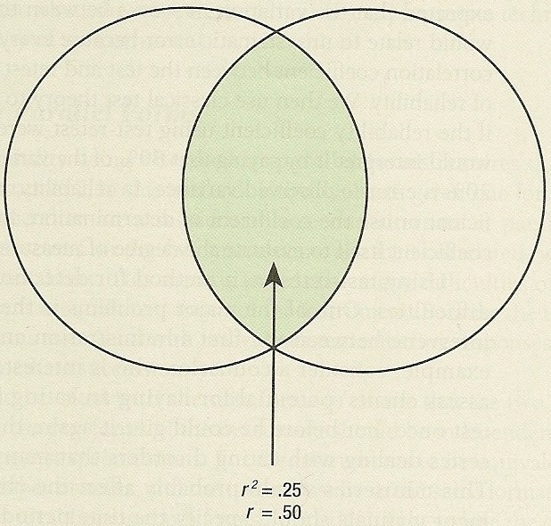
Correlation
Coefficient of Determination – the percentage of common variances between the two sets of data
  This is done by squaring the correlation coefficient (r²)
    E.g., if the correlation coefficient is 0.50 then the coefficient of determination (shared variance) is 0.25 (r² = 0.50²)

Slide 11
Types of Reliability
Test-Retest – reliability coefficient is calculated by correlating the performance on the first administration with the performance of the second administration
  Can be affected by “events” that occur between first and second administration
  Reliability coefficients tend to decrease as the amount of time between the testing increases
  Three assumptions must be met:
    The characteristics or trait that is being measured must be stable over time
    There should be no differential practice effect
    There should be no differential in learning between the test and the retest

Slide 12
Types of Reliability
Parallel-Forms – an individual is given one form of the instrument initially and then assessed with the second (alternate or parallel) form of the instrument; the correlated scores on the two instruments results in an estimate of reliability
  Can be given in immediate succession
  Avoids many of the difficulties with test-retest
  Much care should be taken to make sure the alternate forms to ensure that the two forms are truly parallel
    E.g., make sure one form is not more difficult than the other
  Not often seen in counseling because it is difficult to develop even one sound instrument
  The first instrument still may have some influence on the administration of the second instrument

Slide 13
Types of Reliability
Inter-Rater – having a sample of tests (i.e., scores), or observations, independently scored by two or more examiners
  The two scores obtained by each test taker are then correlated
  This typically used when “judgment of the scorer” is required

Slide 14
Types of Reliability: Internal Consistency
Split-Half – the instrument is given once and then split in half to determine the reliability
  Often divided in half by using the scores form the even items and the scores from the odd items
  After the instrument has been divided into two halves, each score on the two halves is correlated
    This is a problem because a correlation is influenced by the number observations in the calculation – the larger the number of observations, the larger the correlation coefficient
      E.g., if 50 items, the split-half method provides an estimate of reliability based on 25 items
    The Spearman-Brown formula corrects this problem by providing an estimate of what the reliability coefficient would be if the halves were increased to the original length of the instrument
    Should only use Spearman-Brown coefficients with other S-B coefficients

Slide 15
Types of Reliability: Internal Consistency
Kuder-Richardson – used when scoring is dichotomous
  KR-20 – appropriate for instruments that are heterogeneous
  KR-21 – appropriate for instruments that are homogenous

Slide 16
Types of Reliability: Internal Consistency
Cronbach’s Alpha (a) – the appropriate method of estimating reliability when the scoring is not dichotomous (e.g., strongly agree, agree, neutral, disagree, strongly disagree)
  Takes into account the variance of each item
  Usually low and conservative estimates of reliability
  Also known as Coefficient Alpha

Slide 17
Evaluating Reliability Coefficients
Examine purpose for using instrument
Have knowledge about the reliability coefficients of other instruments in area
Examine characteristics of particular clients against reliability coefficients
  SES
  Age
  Culture/ethnicity

Slide 18
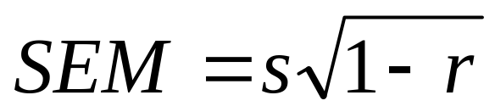
Standard Error of Measurement
Standard Error of Measurement – Provides an estimation of the range of scores if someone were to take an instrument repeatedly
Based on the premise that when individuals take a test multiple times, the scores fall into a normal distribution
68% of the time the true score falls between 1 SEM below the original score and 1 SEM above
95% = 2 SEM
99.5% = 3 SEM

Slide 19
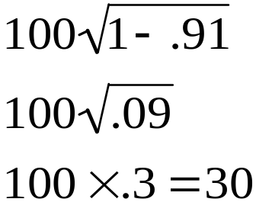
Example 1 of SEM
Sam’s SAT Verbal = 550
  r = .91; s = 100
  SEM =
  68% of the time, Sam’s true score would fall between
    520 and 580
  95% of the time, Sam’s true score would fall between
    490 and 610
  99.5% of the time, Sam’s true score would fall between
    460 and 640

Slide 20



Example 2 of SEM
Sam’s SAT Verbal = 550
  r = .70; s = 100
  SEM =
  68% of the time, Sam’s true score would fall between
    495 and 605
  95% of the time, Sam’s true score would fall between
    440 and 660
  99.5% of the time, Sam’s true score would fall between
    385 and 715

Slide 21
Standard Error of Measurement
SEM will always increase as reliability decreases
Important to consider if the instrument’s reliability varies depending on ability level, age, or other factors
SEM is more appropriate for individual scores while the reliability coefficient is often best to compare different instruments
Best to provide clients with a range of scores rather than reporting only one score
Assessment results should be interpreted by using a range of scores based on SEM

Slide 22
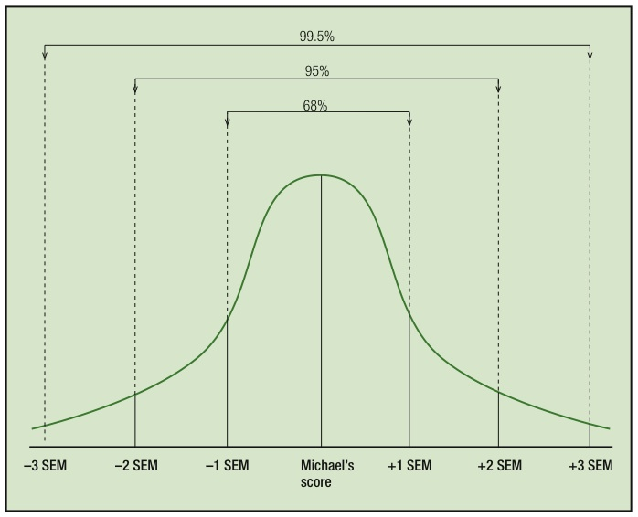
Using SEM to
Evaluate a Score

Slide 23
Standard Error of Difference
Standard Error of Difference – a measure used to examine the difference between two scores and determine if there is a significant difference
  In examining the differences between the two scores, counselors need to take into account the errors of measurement from both scores
    If the bands overlap, then it should not be concluded that the two scores are different
    Differences can be attributed to areas where there is no overlap between bands

Slide 24
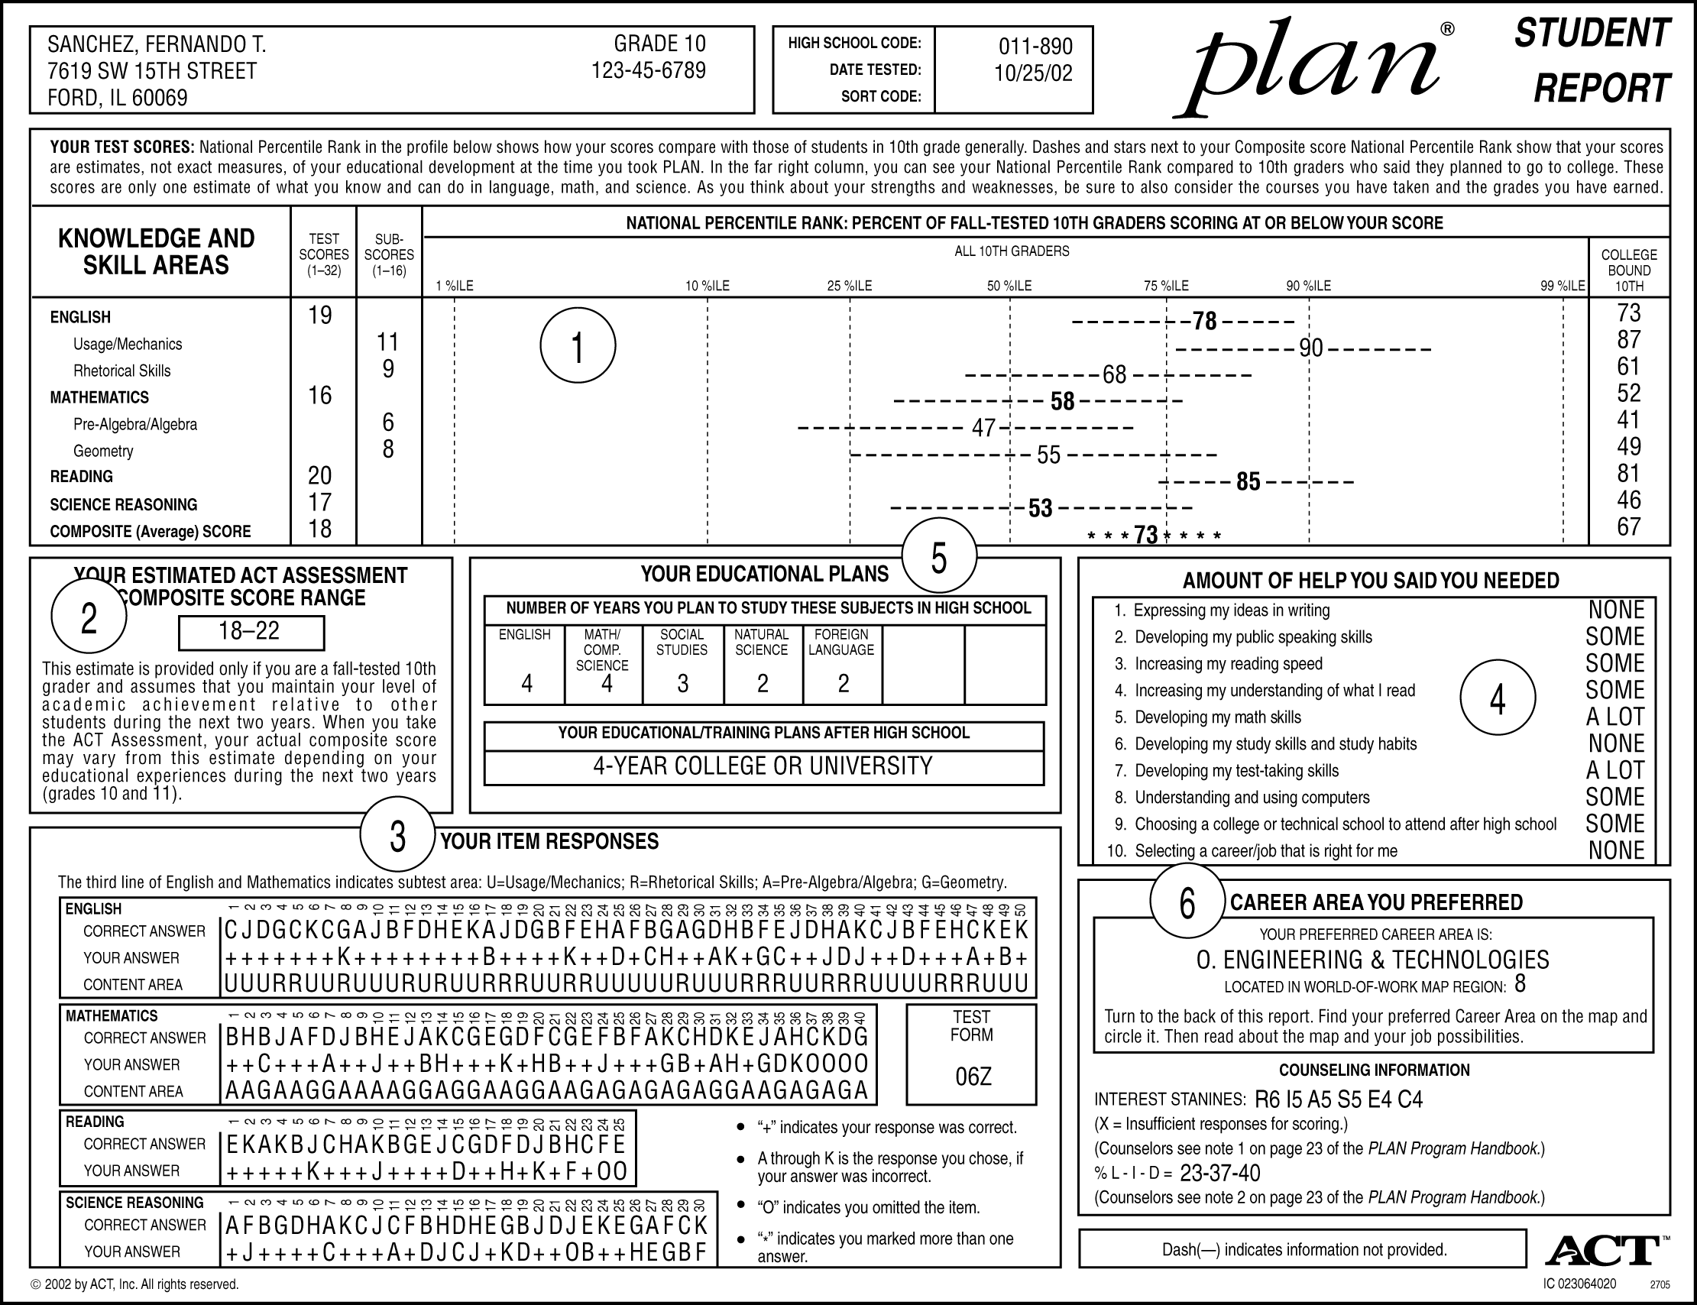
Standard Error of Difference

Slide 25
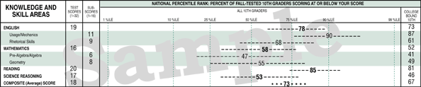
Standard Error of Difference

Slide 26
Alternative Theoretical Model
Generalizability Theory (Domain Sampling Theory)
  Focus is on estimating the extent to which specific sources of variation under defined conditions are contributing to the score on the instrument.
  Stated differently: The focus is on the degree to which scores can be generalized across alternative forms, test administrators, number of items, and other facets of assessment
  The term universe score, rather than true score, is used to represent the average of taking the instrument multiple times in the same universe (e.g., same purpose and same conditions)
  Purpose is to identify specific sources of variation, which results in multiple coefficients of generalizability
    E.g., practice effects, examinee’s motivation, administration styles, room temperature
  This theory requires multiple reliability coefficients or coefficients of generalizability… combine reliability estimates across studies (meta-analysis) – reliability generalization

