Slide 1
Assessment in Counseling (Part A):
Nature and Use of
Psychological Tests in Counseling
PSY 504: Psychological Measurement

Slide 2
What is Assessment?
Many of the definitions of assessment have some commonalities:
  Getting a measure or using some type of measurement (i.e., psychological test)
  Sample(s) of behavior in which we make inferences
  An objective or systematic measure of behavior
  Measure some aspect of the client
Notes:
***

Slide 3
Assessment is Integral to Counseling
Essential steps in counseling:
Assessing the client problem(s)
Conceptualizing and defining the client problem(s)
Selecting and implementing effective treatments
Evaluating the counseling
Notes:
Epperson, Bushway, and Warman (1983) found that clients are more likely to continue in counseling if they and the counselor agree on the nature of the problem
Must continually assess clients; strong predictor of negative outcomes in counseling is underestimating the severity of the client’s problems
Assessment continues through treatment (knowledge of problem; treatment efficacy); want new information to encourage learning and insight; balance between assessing strengths and limitations
Assess/evaluate effectiveness of treatment for both accountability and client
***

Slide 4
Assessment Can Be Therapeutic
Therapeutic Assessment Model (Finn, 1997)
  Establish a relationship with the client and work collaboratively towards individualized assessment goals
  Feedback – interactive interpretation
  Assist clients in decision making
Notes:
--begin with feedback that most closely matches clients’ preconceived notions and then move on to more discrepant information
--clients who received interactive interpretation considered their sessions to be deeper and rated the counselor as being more expert, trustworthy, and attractive (i.e., better outcomes and improved perception of the counselor)
***

Slide 5
What Do Counselors Need to Know About Assessment?
Skill in practice and knowledge of theory relevant to the testing context and type of counseling specialty
A thorough understanding of testing theory, techniques of test construction, test reliability and validity
A working knowledge of sampling techniques, norms, and descriptive, correlational and predictive statistics
Ability to review, select, and administer tests appropriate for clients or students and the context of the counseling practice
Notes:
***

Slide 6
What Do Counselors Need to Know About Assessment?
Skills in administration of tests and interpretation of test scores
Knowledge of the impact of diversity on testing accuracy, including age, gender, ethnicity, race, disability, and linguistic differences
Knowledge and skill in the professionally responsible use of assessment and evaluation practice
Notes:
***
--important: need for multiple sources of convergent data, staying abreast of assessment issues, and consulting with professionals on interpretations; counselors knowing their limits of their own assessment competency

Slide 8
Uses and Varieties of
Psychological Tests
Major precipitant for psychological tests was for the identification of “mentally retarded persons”
  Binet-Simon scale (published in 1905) ratio of mental age to chronological age (intelligence quotient – IQ)
    Stanford-Binet scale (published in 1916)
  Education - detection of intellectual deficiencies and achievement/ability remains important

Slide 9
Uses and Varieties of
Psychological Tests
Selection and classification of industrial personnel
Selection and classification of military personnel
  World War I & II
  First group-administered intelligence tests
    Army Alpha – routine testing (language)
    Army Beta – nonlanguage for use with illiterate or non-English

Slide 10
Uses and Varieties of
Psychological Tests
Educational and vocational plans/needs
  Frank Parsons – “father of guidance”
    Developed one of the first approaches to career counseling
      Understand the person and the world of work, and match the person
Emotional well-being and effective interpersonal relations
Self-understanding and personal development
Tests are also important for research

Slide 11
What is a Psychological Test? –
Behavior Sample
An objective and standardized measure of a sample of behavior
Test items do not need to resemble closely the behavior the test is to predict
  Simply need an empirical correspondence
Tests are behavior samples from which predictions regarding other behavior can be made
Capacity = potential for learning

Slide 12
What is a Psychological Test? - Standardization
Standardization – uniformity of procedure in administering and scoring the test
  Directions for administration must be followed
Norms – “normal or average performance”
  An individual test score is interpreted by comparing it with the scores of others who have taken the same test
  Established by administering a new test to a large, representative sample of the type of persons for whom it is designed for (i.e., standardization sample)
Notes:
If the scores obtained by different persons are to be comparable, testing conditions must obviously be the same for all.
Administration – exact materials employed, time limits, oral instructions, preliminary demonstrations, ways of handling queries from test takers; giving instructions – rate of speaking, tone of voice, inflection, pauses, and facial expression

Slide 13
What is a Psychological Test? – Objective Measurement of Difficulty
Administration, scoring, and interpretation of scores are objective insofar as they are independent of the subjective judgment of the particular examiner
Determination of difficulty level, arrangement, selection of items for inclusion in a test
  Item Analysis – discussed later in the semester
Notes:
1) Any one test taker should theoretically obtain the identical score on a test regardless of who happens to be the examiner

Slide 14
What is a Psychological Test? – Reliability & Validity
Reliability = consistency
Validity = the degree to which the test actually measures what it purports to measure
  Tells what the test is measuring

Slide 15
Why Control the Use of
Psychological Tests?
Two principal reasons for controlling the use of psychological tests
  1) ensure that the test is given by a qualified examiner and that the scores are properly used
  2) prevent general familiarity with the test content (in order to avoid invalidation)
Notes:
See p. 10 for five quotes

Slide 16
Why Control the Use of
Psychological Tests? – Qualified Examiner
Three major reasons
  1) selection of test
  2) administration and scoring
  3) interpretation of scores

Slide 17
Why Control the Use of
Psychological Tests? – Role of the Test User
The test user is anyone who uses test scores as one source of information in reaching practical decisions
  May or may not be the examiner who administers and scores the test

Slide 18
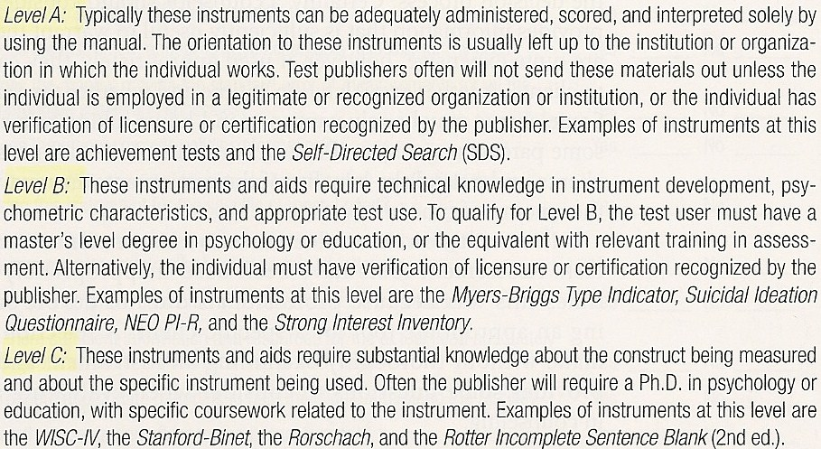
Why Control the Use of
Psychological Tests? – Role of the Test User
Development of Qualifications for Users

Slide 19
Why Control the Use of Psychological Tests? – Security of Test Content & Communication of Test Information
Test content should be restricted in order to prevent efforts to fake scores or invalidation from familiarity
Communication
  Dispel the mystery/unknown of tests
  Technical procedures – e.g., reliability, validity; often provided in test manual
  Familiarize with testing procedures, dispel anxiety, and ensure best performance
  Feedback provided to test takers on their performance

Slide 21
Test Administration
Advance Preparation of Examiners
Testing Conditions
Rapport & Test-Taker Orientation
  Rapport – the examiner’s efforts to arouse the test takers’ interest in the test, elicit their cooperation, and encourage them to respond in an appropriate manner
  Provide each test taker an explanation, or materials, in advance that explain the purpose and nature of the tests
Notes:
Memorizing the exact verbal instructions is essential in most individual testing; preparation of test materials; familiarity with specific testing procedures
Selection of a suitable room – free from noise, distraction and interruption; adequate lighting, ventilation, seating facilities, working space for test takers

Slide 22
Examiner and Situational Variables
Test results may be influenced by the examiner’s behavior immediately preceding and during test administration
  e.g., warm vs. cold; rigid vs. aloof
  Examiner characteristics may have different effects on different examinees
Examiner’s own expectations – self-fulfilling prophecy
Test takers’ activities and/or emotional disposition preceding the test
Feedback effects on subsequent test performance

Slide 23
Test-Taker’s Perspective
One purpose of rapport is to reduce test anxiety
  Being well mannered, organized, and smooth testing techniques help greatly
    Relation between anxiety and performance is nonlinear
      Inverse “U” – slight amount of anxiety is beneficial while a large amount is detrimental
  “freezes up”
    anxiety → poor testing OR
    poor study skills → poor testing → anxiety
  Elimination of emotionality (i.e., physiological) and worry (i.e., cognitive), and improvement of study skills appears to help best

Slide 24
Effects of Training on Test Performance
Coaching – not good – intensive, massed drill on items similar to those on the test
  Might improve test performance, but without corresponding improvement in criterion behavior
    Reduces test validity
Test orientation/sophistication – okay – purpose is to reduce influence of test-specific factors
Broad Cognitive Skills – good – development of applicable intellectual skills, work habits, and problem-solving strategies
  Both test scores and criterion performance improved

Slide 25
Sources of Information about Tests
Mental Measurements Yearbook
  Established and edited by Oscar K. Buros through 1978 (first edition published in 1939)
  Covers nearly all commercially available psychological, educational, and vocational tests published in English
  Provides critical reviews by one or more test experts and a detailed description with relevant references
Test Collection of Bibliographies by the Educational Testing Service (ETS)
Standards for Educational and Psychological Testing by the APA

