Slide 1
Behavioral Activation: Monitoring, Scheduling, Moving, and Getting Things Done
Chapter 6

Slide 2
Behavioral Activation

Slide 3
Behavioral Activation
Beck et al. (1979) included behavioral activation, through “activity scheduling,” as a key CBT-specific factor for the treatment of depression
  *Activity scheduling was first developed by Lewinsohn (1972, 1973) known as “pleasant events scheduling”
The primary goal of behavioral activation in CBT is to reduce negative reinforcing behavior patterns (e.g., social isolation or a reduction in daily routines) while increasing positive reinforcing behavior patterns (e.g., spending time with friends/family or completing tasks)

Slide 4
Behavioral Activation
Typically the first interventions used during the early phase of therapy
Significantly distressed individuals tend to have low levels of energy and negative automatic thoughts/emotions
  Hard to initiate and complete basic daily tasks and activities
  Reduced accomplishment and pleasure; low self-efficacy
  Vicious cycle perpetuates maladaptive cognitive-emotional-behavioral patterns as new baseline
    Feel “stuck” or “in a rut”

Slide 5
Behavioral Activation
Want to get clients “moving in the opposite direction” to break their maladaptive cognitive-emotional-behavioral patterns
Initial primary target area is behaviors, not thoughts
Behavioral activation is relatively simple and tangible
  Good opportunity for shared experience of “therapeutic successes”
    Can naturally reinforce the collaborative nature of CBT

Slide 6
Behavioral Activation
Figure 6.1 – Behavioral Inactivity and Distress
  Visual depiction of how behavioral inactivity and low accomplishment and pleasure develop into distressing maladaptive cognitive and behavioral patterns
The two most common and effective forms of behavioral activation are activity monitoring and scheduling and graded task assignments

Slide 8
Activity Monitoring and Scheduling

Slide 9
Psychoeducation and Assigning Weekly Activity Monitoring Logs
Monitoring activities is one of the first interventions and homework assignments
  Successful implementation can increase motivation to change
Initial psychoeducation naturally highlights the attractiveness of behavioral activation
  Relatively simple to follow
  Nonthreatening
  Provide some immediate distress relief

Slide 10
Psychoeducation and Assigning Weekly Activity Monitoring Logs
Table 6.1 – Psychoeducation for Activity Monitoring and Scheduling
  Provides key points that should be addressed when initiating psychoeducation
  Figure 6.1 can also be used to supplement your psychoeducation

Slide 11
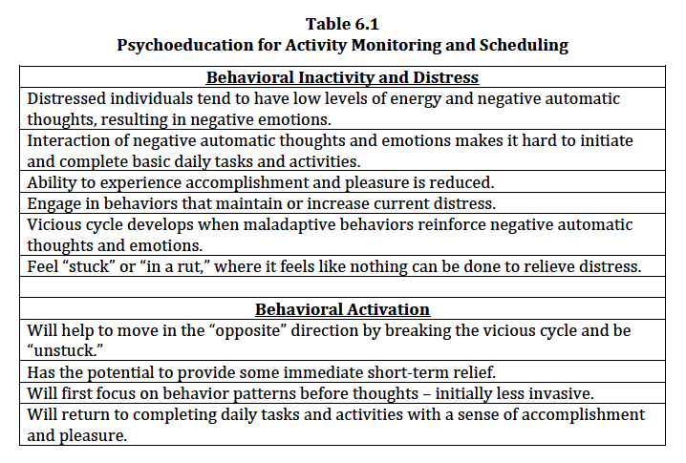

Slide 12
Psychoeducation and Assigning Weekly Activity Monitoring Logs
First need to assess clients’ current baseline in order to know where to focus on specific target behavior patterns for change
  Best done for at least 1-2 weeks between sessions
Table 6.2 – Weekly Activity Monitoring Log
  Tracks what particular activities are completed at specific times during the day

Slide 13
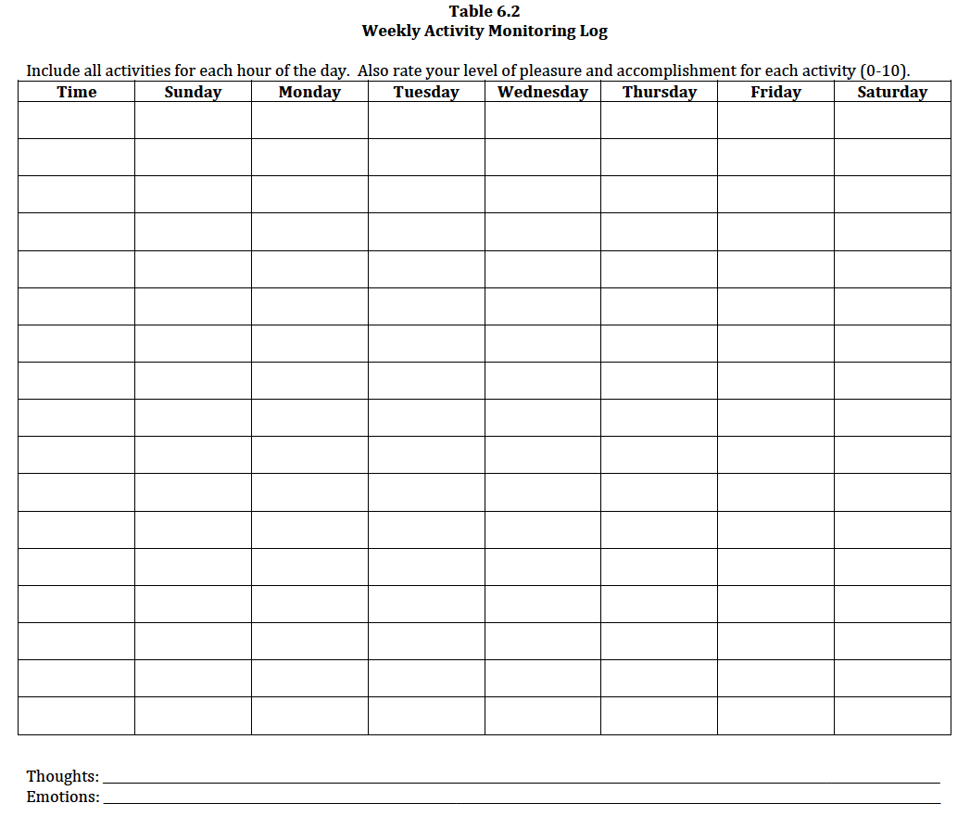

Slide 14
Psychoeducation and Assigning Weekly Activity Monitoring Logs
Weekly Activity Monitoring Log
  Includes space for each day of the week and to write down what activity was completed a 1-hour intervals
  Clients should record every activity they engage in, including what they may perceive as very mundane tasks (e.g., waking up, taking a shower, chores, meals, work activities, interactions with others, going to sleep)
    Such activities are some of the best indicators of distress severity
  Rate levels of pleasure and accomplishment on a 0-10 scale (optional)
  Space at the bottom to record any thoughts or emotions
  Important to review next session

Slide 15
Psychoeducation and Assigning Weekly Activity Monitoring Logs
Video Vignette 6.1 (p. 128)
  MDD-5: Behavioral Activation—Psychoeducation and Introducing Weekly Activity Monitoring Log
Discussion Questions 6.1 (p. 131)
Activity 6.1: Behavioral Activation—Weekly Activity Monitoring Log (p. 131)

Slide 16
Reviewing Completed Weekly Activity Monitoring Logs and Assigning Daily Activity Schedules
Reviewing your clients’ completed Weekly Activity Monitoring Log should be your top agenda item for the next session
Consider asking the following questions when processing your clients experience:
  Was this an easy or a challenging task?
  Was this an enjoyable or an unpleasant experience?
  Did they learn anything about themselves?
  How do they feel?
  What is their current motivation/hope?
Monitor clients’ nonverbal behavior when reporting their experience

Slide 17
Reviewing Completed Weekly Activity Monitoring Logs and Assigning Daily Activity Schedules
Table 6.3 – Weekly Activity Monitoring Log Evaluation Questions
  Provides a list of questions to help evaluate your clients’ activity log (across days and time):
    Completed and uncompleted activities
    Pleasurable and unpleasant activities
    Activities that elicit accomplishment and those that do not
    Distressing and inhibiting automatic thoughts
    Involvement with other people

Slide 18
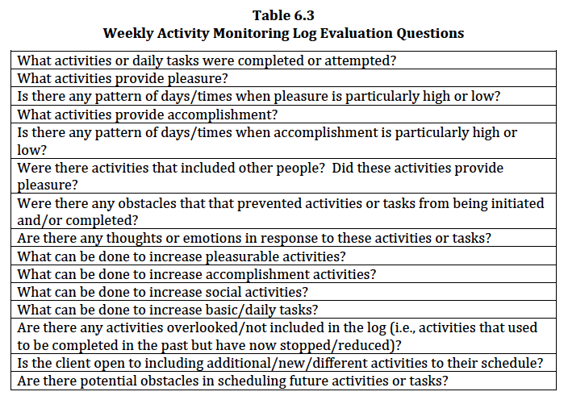

Slide 19
Reviewing Completed Weekly Activity Monitoring Logs and Assigning Daily Activity Schedules
Table 6.4 – Daily Activity Schedule
  Used after obtaining a baseline of your clients’ daily activities to schedule activities and tasks for a specific day with attainable goals
  Similar to the activity log but does have a few distinct features:
    Focuses on one specific day
    Planned and actual activity to track follow-through
    Expected pleasure (before activity) and actual pleasure (after activity) along with accomplishment
    Tracks associated thoughts (believability rating) and emotions (intensity rating) for each planned/actual activity

Slide 20
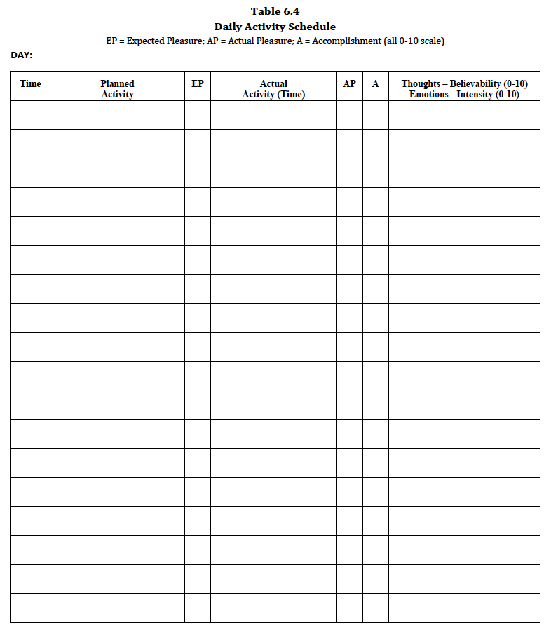

Slide 21
Reviewing Completed Weekly Activity Monitoring Logs and Assigning Daily Activity Schedules
Daily Activity Schedule
  Let clients decide on the specific activities to schedule as much as possible
    You should still be an active guide by providing suggestions based on information from your clients’ activity log and evaluation questions
  Chosen activities should have therapeutic relevance to your clients and are practical
    Helpful to start off with potentially pleasurable and productive activities
    Include some activities that may be perceived as small or minor
      e.g., showering, laundry, cooking a meal

Slide 22
Reviewing Completed Weekly Activity Monitoring Logs and Assigning Daily Activity Schedules
Daily Activity Schedule
  Number of activities to schedule depends on client factors
    e.g., level of distress, time of day, time between tasks, complexity of tasks, inclusion of others (family/friends)
    Best to start off with “easier” options and work toward those that are more challenging
  Review planned activity and actual activity
    Ideally, clients should write their planned activities the day before
    The actual activity column provides the opportunity to either confirm the planned activity or allow for modifications
      Convey to your clients that it is okay if not all activities go as planned; do their best to be flexible

Slide 23
Reviewing Completed Weekly Activity Monitoring Logs and Assigning Daily Activity Schedules
Daily Activity Schedule
  Clients can also rate their expected pleasure before and after the activity; and accomplishment after the activity (0-10 scale)
  Last column allow for clients to write any thoughts or emotions they have following an activity, even if not initiated or completed
    Rate believability for thoughts and intensity for emotions (0-10 scale)
  Might be necessary to troubleshoot for potential obstacles
    Preventative plan to prepare for the unexpected
  Behavioral experiments can be helpful for skeptical clients
    Purposeful passive approach – “give it a shot”

Slide 24
Reviewing Completed Weekly Activity Monitoring Logs and Assigning Daily Activity Schedules
Video Vignette 6.2 (p. 137)
  MDD-6: Behavioral Activation—Reviewing Completed Weekly Activity Monitoring Log
Video Vignette 6.3 (p. 139)
  MDD-7: Behavioral Activation—Introducing Daily Activity Schedule
Discussion Questions 6.2 (p. 141)
Activity 6.2: Behavioral Activation—Review Completed Activity Monitoring Log (p. 142)
Activity 6.3: Behavioral Activation—Daily Activity Schedule (p. 142)

Slide 25
Reviewing Completed Daily Activity Schedules and Moving Forward
Reviewing completed Daily Activity Schedules is similar to reviewing completed Weekly Activity Monitoring Logs
  Transition from assessment of baseline behavior to interventions for changing behaviors
Table 6.5 – Daily Activity Schedule Evaluation Questions
  Provides a list of questions to help evaluate your clients’ Daily Activity Schedule

Slide 26
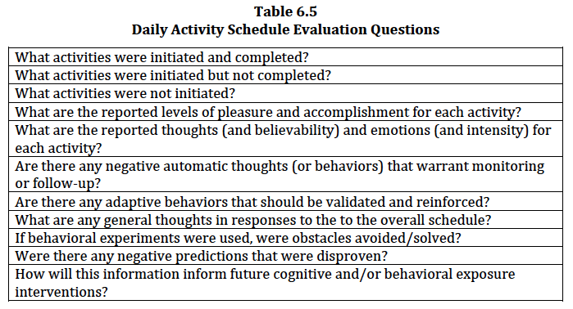

Slide 27
Reviewing Completed Daily Activity Schedules and Moving Forward
Focus on recognizing and praising clients’ efforts, even for some activities that may have not been fully completed
Also emphasize the value of clients giving themselves credit for completing tasks that may be perceived as small/minor
  Often provides the most immediate distress relief
Be sure clients give themselves credit for their progress instead of externalizing success (e.g., therapist, others, luck)
  Increase: self-efficacy, autonomy, motivation, and hope

Slide 28
Reviewing Completed Daily Activity Schedules and Moving Forward
Review clients’ ratings of pleasure and accomplishment
  Low levels of of pleasure or accomplishment (e.g., a rating of 3 or 4) should not be downplayed
    e.g., a completed task with a pleasure rating of 3 in the recent past was not even being attempted and/or not eliciting any pleasure
    Some activities are generally not inherently pleasurable or do not produce high levels of accomplishment
Assess preparedness and response to any potential obstacles, including any behavioral experiments
  Most predictions will be found to be invalid

Slide 29
Reviewing Completed Daily Activity Schedules and Moving Forward
Video Vignette 6.4 (p. 144)
  MDD-8: Behavioral Activation—Reviewing Completed Daily Activity Schedule
Discussion Questions 6.3 (p. 147)
Activity 6.4: Behavioral Activation—Review Completed Daily Activity Schedule (p. 147)
Activity 6.5: Behavioral Activation—Introducing and Reviewing Weekly Activity Monitoring Log and Daily Activity Schedule (p. 147)

Slide 30
Graded Task Assignments

Slide 31
Graded Task Assignments
There may be some tasks that are “bigger” – can often be overwhelming for some clients
  A graded task assignments (GTA) may be a viable option to help make these overwhelming tasks more manageable by breaking them down into smaller tasks
    Can be less overwhelming and provide more opportunities for accomplishment and pleasure
    Can also be used for clients who are not ready or motivated to follow through with a full Daily Activity Schedule

Slide 32
Graded Task Assignments
When clients are unable to complete a task it is often due to being overwhelmed by the magnitude of the task (e.g., “It’s just too big.”)
  Other related factors: steps for the particular task was not broken down enough, the task was too complicated, the task required more energy/motivation than anticipated
GTAs can aid in identifying particular sources of distress or difficulty with a smaller task
  Make sure smaller tasks not only reduce complexity but also match your clients’ level of motivation and energy
    Helps increase pleasure and accomplishment

Slide 33
Graded Task Assignments
Figure 6.2 – Graded Task Assignment Worksheet
  Visual aid for clients that are especially stuck or frustrated with a particular task
  Similar to the Daily Activity Schedule with regard to tracking thoughts, emotions, and ratings of pleasure and accomplishment
    Focus with GTA is breaking down the large task into smaller tasks and a logical sequence with room to report any thoughts and emotions specific to each task

Slide 34
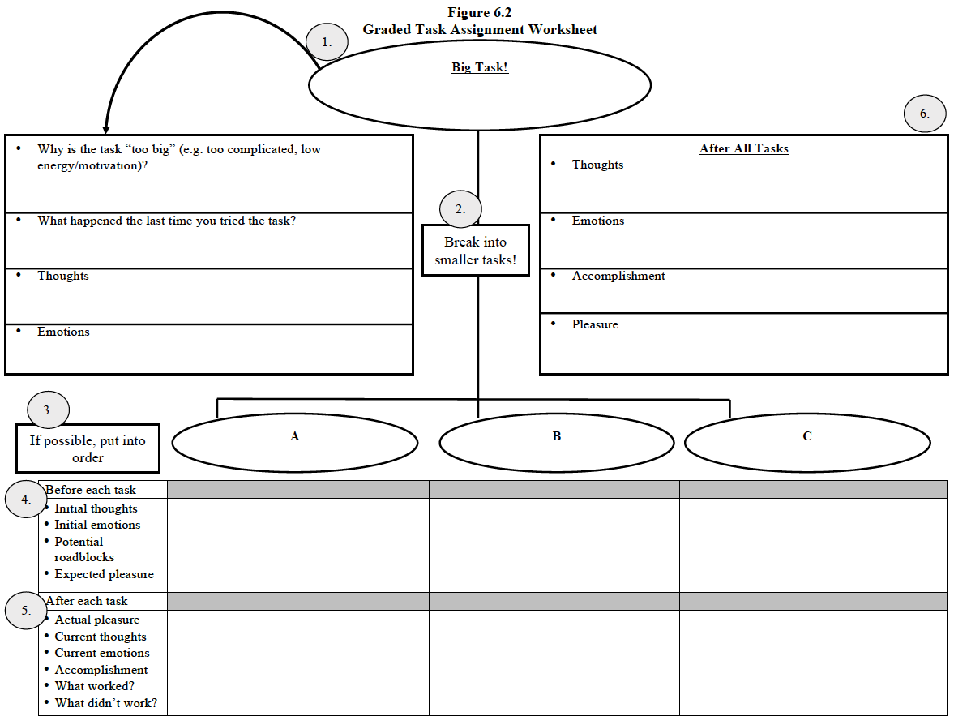

Slide 35
Graded Task Assignments
When initiating the GTA, consider asking:
  What are some reasons that they think the task is “too big?”
  What happened the last time they tried the task?
  What are some immediate thoughts and emotions that come to mind?
When breaking the big task into smaller tasks, have your clients list the tasks in a logical and attainable order for completion
  Discuss alternative approaches before developing a specific action plan
Better to have a task a little too easy than too difficult

Slide 36
Graded Task Assignments
There is space for clients to list thoughts, emotions, and expected pleasure before attempting each smaller task
  Can also report any anticipated potential roadblocks
After the task, clients can again share their thoughts, emotions, actual pleasure, and accomplishments
  Can also report what worked and did not work

Slide 37
Graded Task Assignments
Even if clients state that they were not able to complete all of the small tasks, you will still have the successes of the other completed (and initiated) smaller tasks to build off of
  The completed smaller tasks will provide opportunities to praise their efforts and focus on any reported increase in ratings of pleasure and accomplishment
  Point out that although the bigger task has yet to be completed, they have made multiple successful steps

Slide 38
Graded Task Assignments
Video Vignette 6.5 (p. 150)
  MDD-8: Behavioral Activation—Graded Task Assignment
Discussion Questions 6.4 (p. 153)
Activity 6.6: Behavioral Activation—Graded Task Assignment (p. 154)

Slide 39
Common Challenges for Behavioral Activation

