Slide 1
Social Learning Theory
{Bandura}
1b
708: Cognitive Assessment & Psychotherapy

Slide 2
Theoretical Perspectives
(Bandura, 1977)
“The explanatory power of a psychological theory is gauged by its accuracy in specifying the conditions governing psychological phenomena and the mechanisms by which the determinants produce their effects.” (p. 4)
“The value of a theory is ultimately judged by the power of the procedures it generates to effect psychological changes.” (p. 4)

Slide 3
Theoretical Perspectives
Bandura criticizes traditional personality theories – needs, drives, impulses, etc. below the level of consciousness; traits as explanations of behavior; environment (i.e., response contingencies) as explanations of behavior

Slide 4
Theoretical Perspectives
“Most of the participants in the controversy over the determinants of behavioral variation eventually adopted the view that behavior results from the interaction of persons and situations, rather than from either factor alone.” (p. 9)
  Personal and environmental factors do not function as independent determinants, rather they determine each other.
    Reciprocal Determinism (discussed soon)

Slide 5
Theoretical Perspectives
“Research has demonstrated that people learn and retain behavior much better by using cognitive aids that they generate than by reinforced repetitive performance.” (p. 10)
  Much evidence for the causal influence of cognitions on behavior
Thus, much learning is done by observation of others (in addition to direct experience)

Slide 6
Theoretical Perspectives
“Another distinguishing feature of social learning theory is the prominent role it assigns to self-regulatory capacities. By arranging environmental inducements, generating cognitive supports, and producing consequences for their own actions, people are able to exercise some measure of control over their own behavior.” (p. 13)
In other words, people do have some measure of control over their own behavior → free will

Slide 8
{Origins of Behavior}
Elements of Observational Learning
(Bandura, 1977)
Attention - To learn anything through observation, the learner must first pay attention to the model – people pay attention more to those people they perceive as similar to them and to people whom they perceive as attractive (this can include high status, competence, and power)

Slide 9
Elements of Observational Learning
(Bandura, 1977)
Memory – The learner must also be able to retain the memory of what was done, such as remembering the steps in preparing a dish that was first seen on a cooking show
  The response patterns must be represented in memory in symbolic form
  Imagery and verbal coding are the two most common systems for retention
    These memory codes serve as guides for performance – mental rehearsal (visualizing performance) increases proficiency and retention

Slide 10
Elements of Observational Learning
(Bandura, 1977)
Imitation – The learner must be capable of reproducing, or imitating, the actions of the model
  Involves converting symbolic representations into appropriate actions

Slide 11
Elements of Observational Learning
(Bandura, 1977)
Motivation – The learner must have the desire to perform the action (i.e., actually care)
  Do the actions result in outcomes that are valued? Or are they unrewarding or punishing?

Slide 13
Antecedent Determinants
(Bandura, 1977)
“If people are to function effectively, they must anticipate the probable consequences of different events and courses of action and regulate their behavior accordingly.” (p. 58)
  Anticipation and expectations are a cognitive function
“Humans do not simply respond to stimuli; they interpret them.” (p. 59)

Slide 14
Antecedent Determinants
Anxiety & Defensive Behavior
  “A great deal of human behavior is activated by events which become threatening through association with painful experiences. A prime function of most anticipatory behavior is to provide protection against potential hazards.” (p. 60)
  “Aversive experiences, either of a personal or vicarious sort, create expectations of injury that can activate both fear and defensive conduct.” (p. 61)
  “What such individuals need in order to relinquish their fearful expectations are powerful disconfirming experiences, which verbal assurances alone do not provide.” (p. 62)
    Exposure!

Slide 15
Antecedent Determinants
Vicarious Expectancy Learning
  Our expectations about the outcomes of a particular course of action depend not only on what has happened to us in the past, but also on what we have observed happening to others
  Other people act as models, from whom we learn the probable consequences of particular alternative behaviors
    Positive or negative
  You do not have to perform particular actions yourself in order to learn about them and their consequences

Slide 16
Antecedent Determinants
Vicarious Expectancy Learning: Empathy
  By observing the emotional reactions of others to a stimulus, it is possible to vicariously learn an intense emotional response to that stimulus
  Mirror Neurons
    Neuroscientists discovered mirror neurons in the brains of animals and humans that are active during observational learning

Slide 17
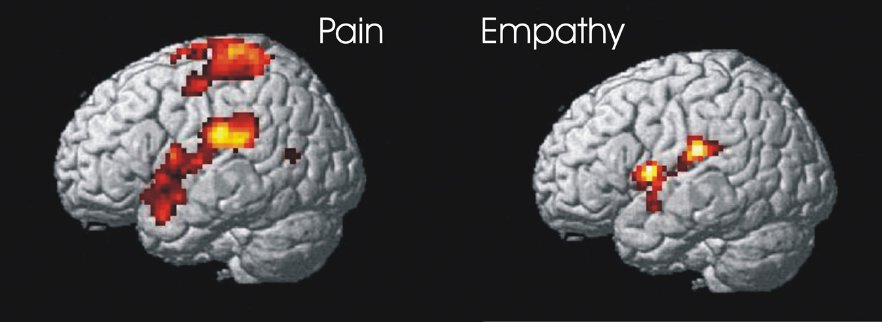
Antecedent Determinants
Below: frontal lobe neurons that fire when performing certain actions or when observing another do so (may enable imitation and empathy)

Slide 18
Antecedent Determinants
Self-Arousal Functions
  You can make yourself feel strong emotions just by thinking about something (or images)

Slide 19
Antecedent Determinants
Dysfunctional Expectancy Learning
  “Because of one’s selective attention or the distinctiveness of events, it is sometimes the coincidental correlates that assume predictive value.” (p. 77)
    i.e., correlation of events can turn into perceived predictive/causal facts
      e.g., anxiety, depression
    “In this process, the inappropriate behavior is maintained by self-produced reality rather than by conditions that have existed in the past but are no longer in effect.” (p. 77)
      i.e., a new reality (but inaccurate) is created and may no longer be related to the initial event/experience
        And, may continue to persist even in the presence of contradictory evidence

Slide 20
Antecedent Determinants
There is more from this chapter
  Will be covered in next lecture as part of self-efficacy and reciprocal determinism

